Slide 1
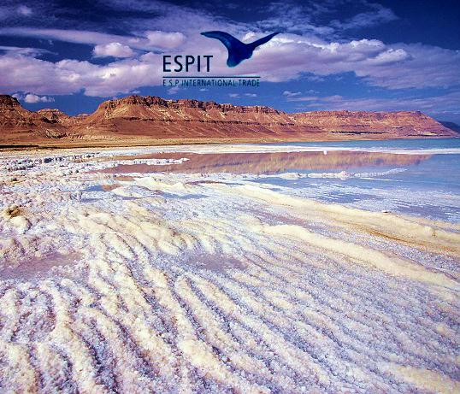
Cosmetic sales
on board cruise ship

Slide 3
Cosmetic sales on board cruise ships
ESPIT Company specializes in selling products sea on board cruise ship.
We are selling cosmetics from the well known Dead Sea in Israel.
The company operates in Destination all over the world – Mediterranean, Europe, South Africa, the Caribbean and South America.
We are looking for sales-persons, motivated and determination – to work in the strongest positions in sales of Dead products.
Cruise ships:
Floating hotel (up to 4,000), making week’s cruise and stop in different places.
Customers in vacation.
On board the ship there are 2 sales-personas that are working as a part of the shop staff on board.
Contract:
The contract is for 6 months.
The sales person will work 7 days a week, 8 HR per day.
While ship is at port there is the possibility to go ashore.
Accommodation living expenses are paid by the company.
Full medical insurance is paid by the company.

Slide 4
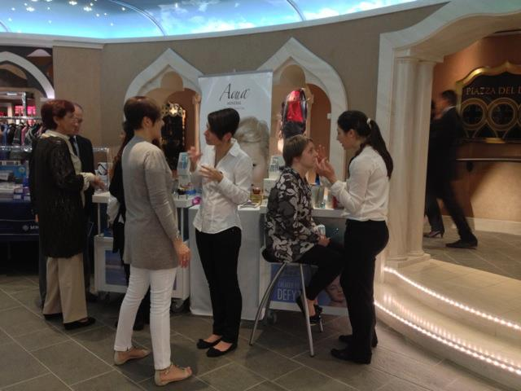

Slide 5
Salary
Basic salary or commission from sales.
Bonuses for meeting company targets.
Salary will be paid to personal credit card that will be issue be the company.
Average salary for sales personal is between $2,000 - $3,000.
Requirements
Basic experience in sales.
Dealing with languages (passengers are coming from different places).
High discipline and motivation.
High responsibility.
Knowing to work under pressure.
Meeting sales targets.
Privies embarkation expenses are needed (shop documents, curses ect… )
Dealing with products stocks, sales reports.
Knowledge of languages helps but not required – Spanish, Italian and German.
Respecting all the ship and safety drills.

Slide 6
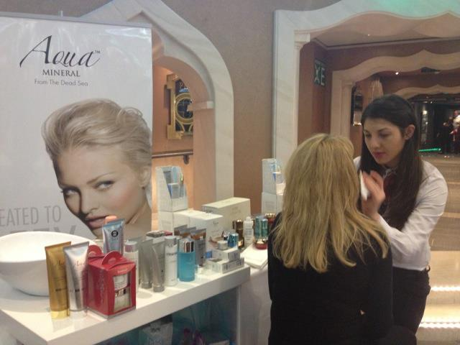

Slide 7
Based on the Dead Sea Minerals & Organic anti-age line Sea of spa Natural Hand made soaps Demo Soaps

Slide 8
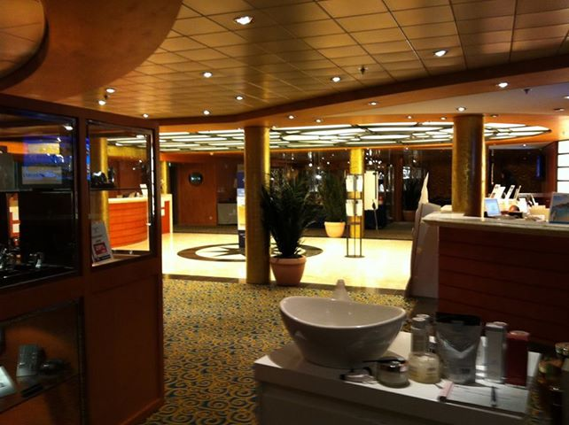

Slide 9
!!! come and join our success

